Slide 1

Your Tech Bootcamp
Group 6 - Main’Terprète
Sign language translation

Slide 2
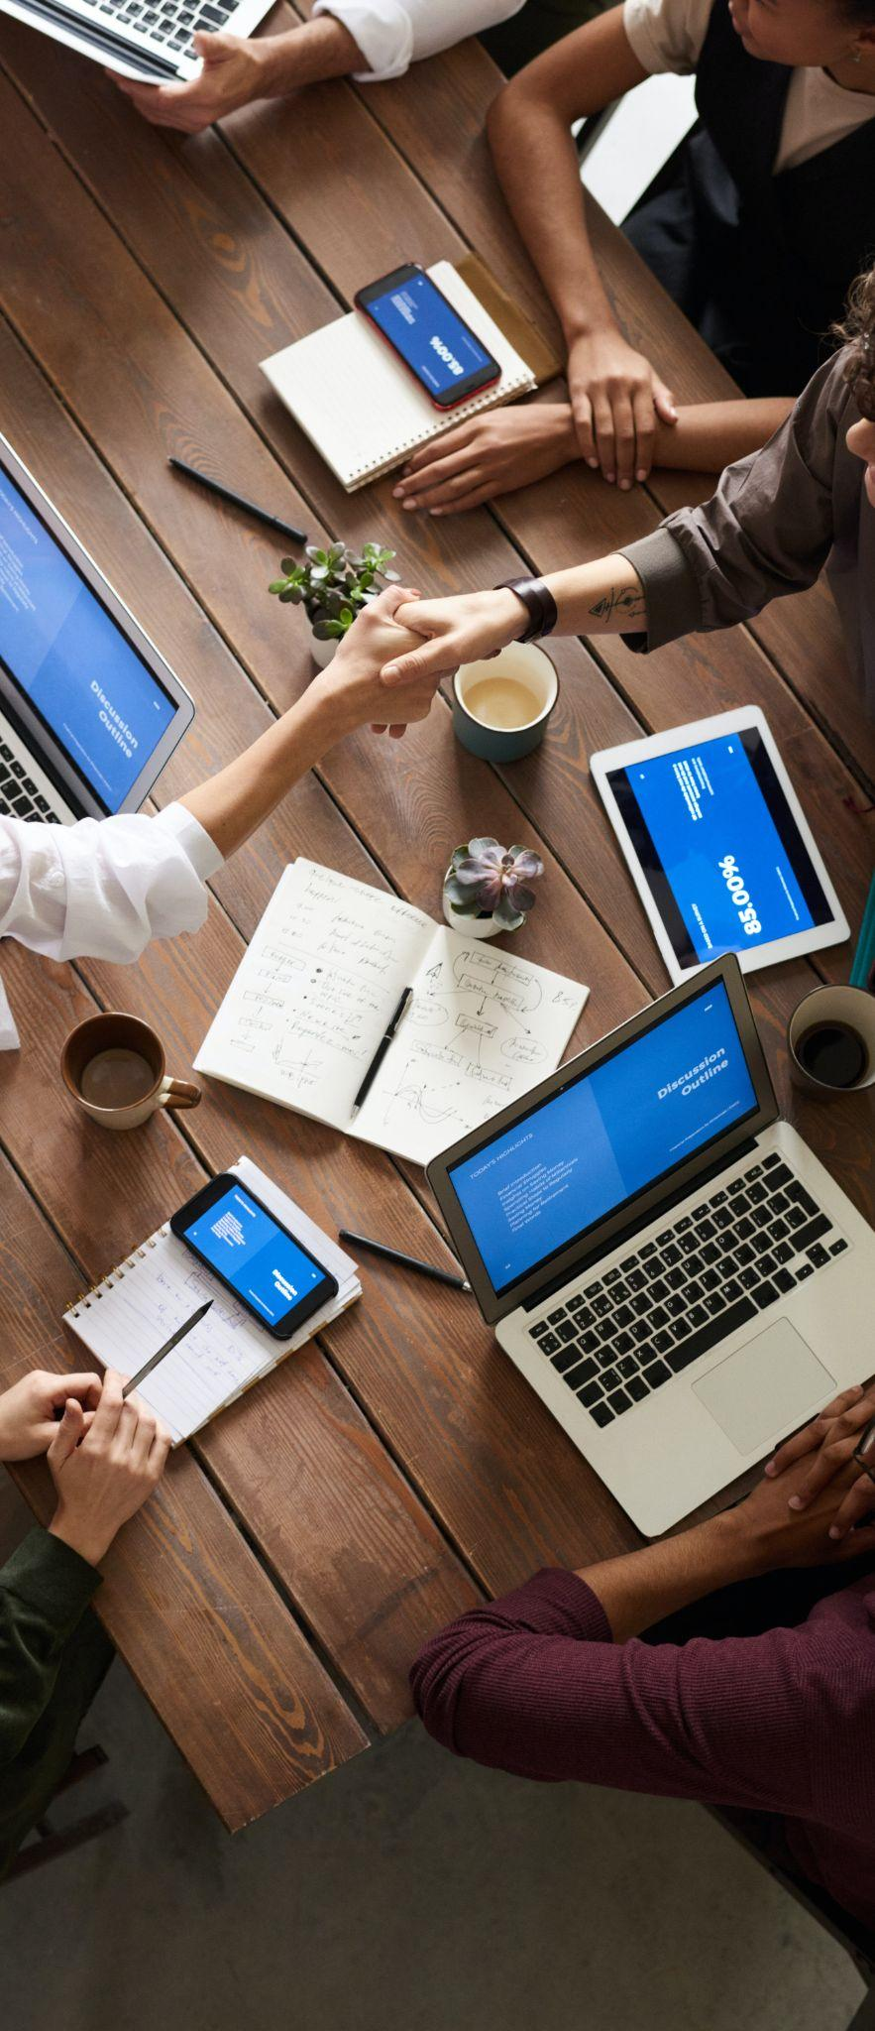

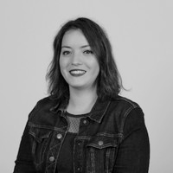

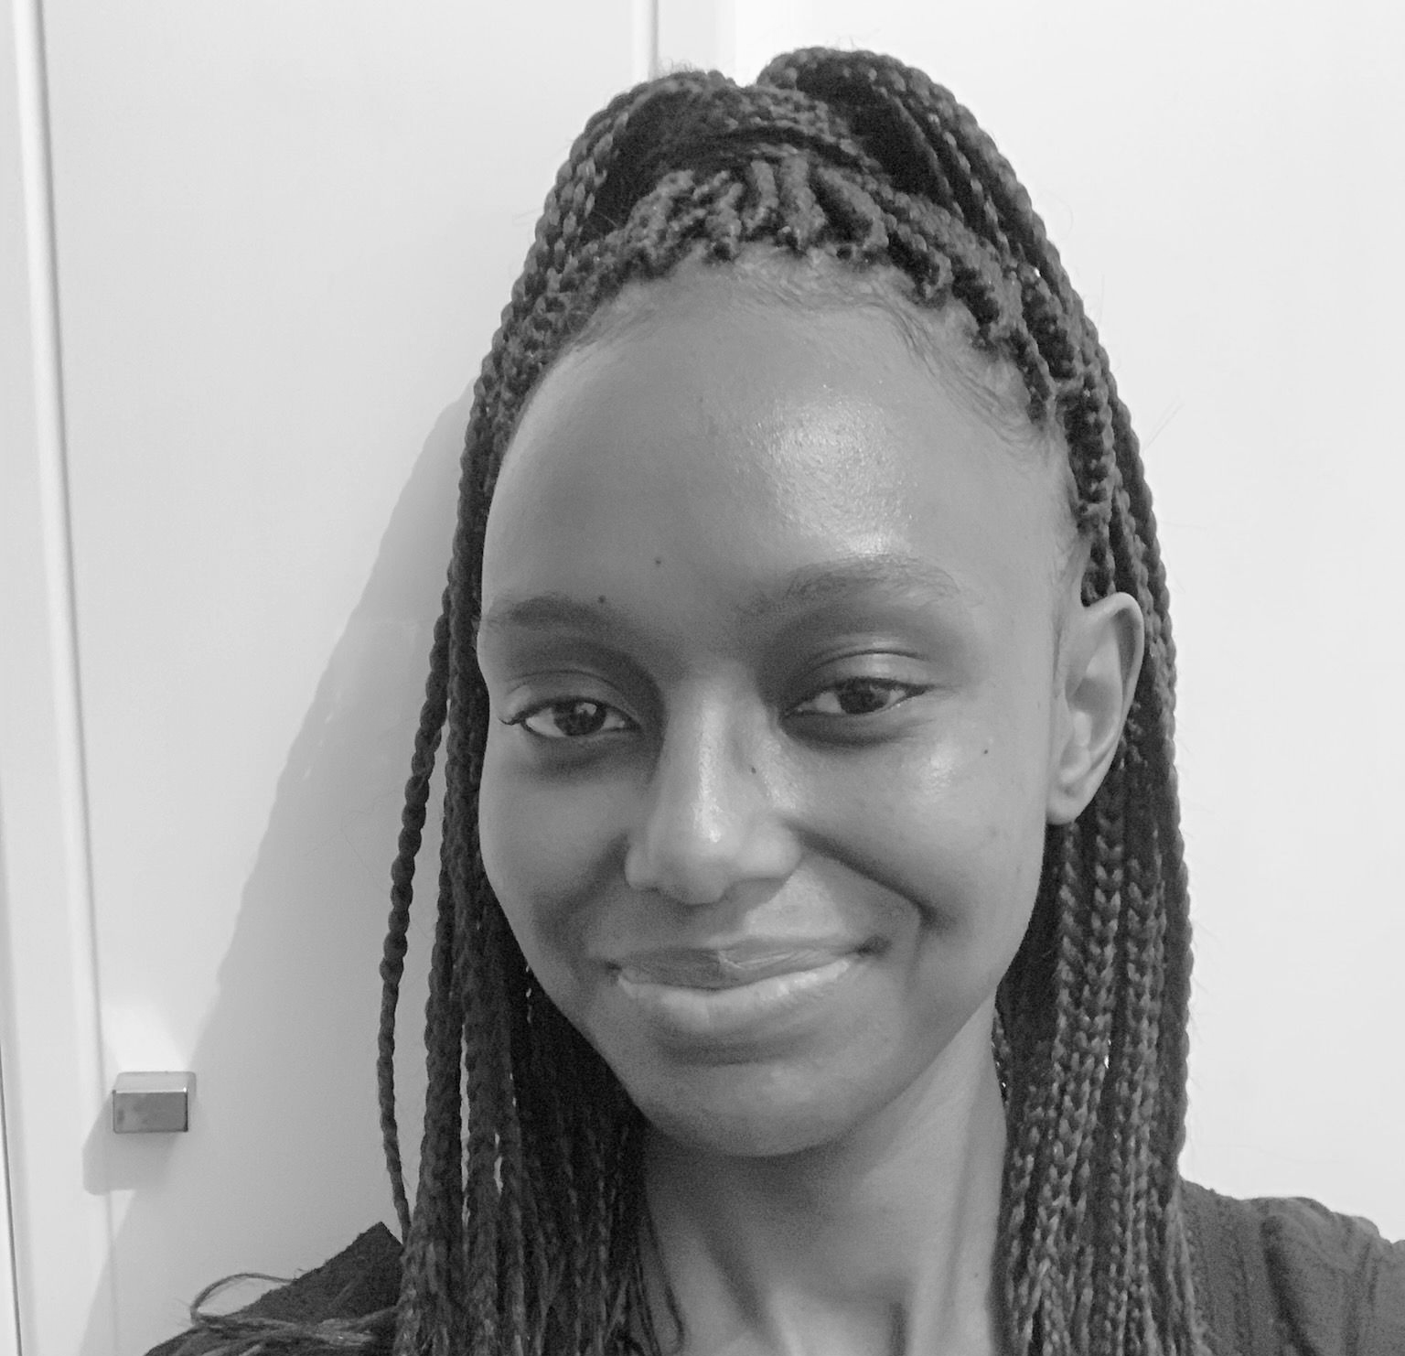
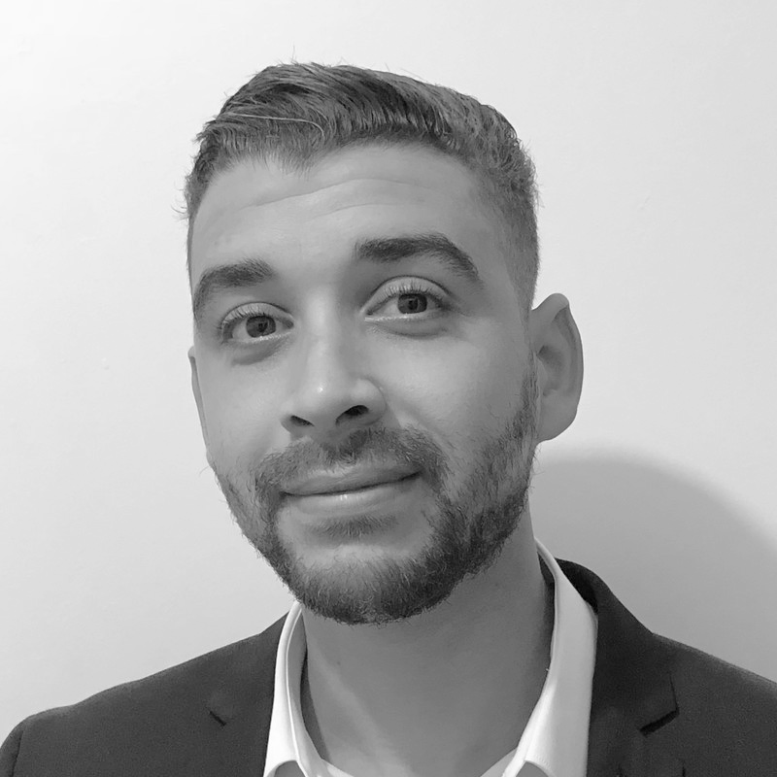
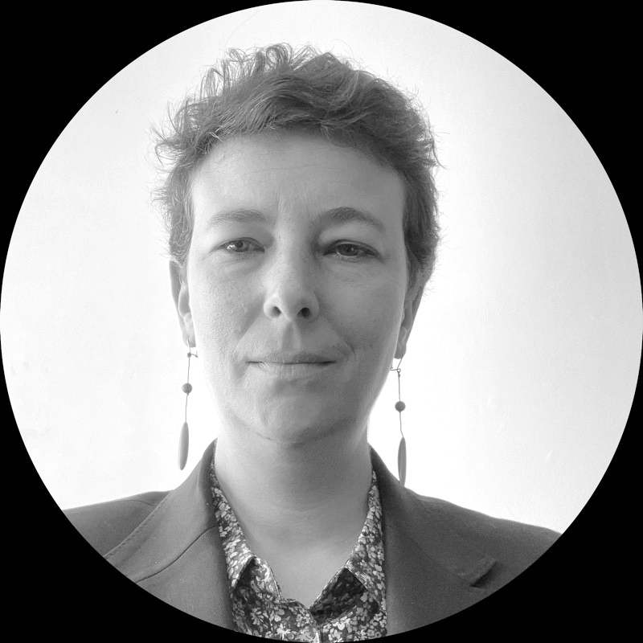
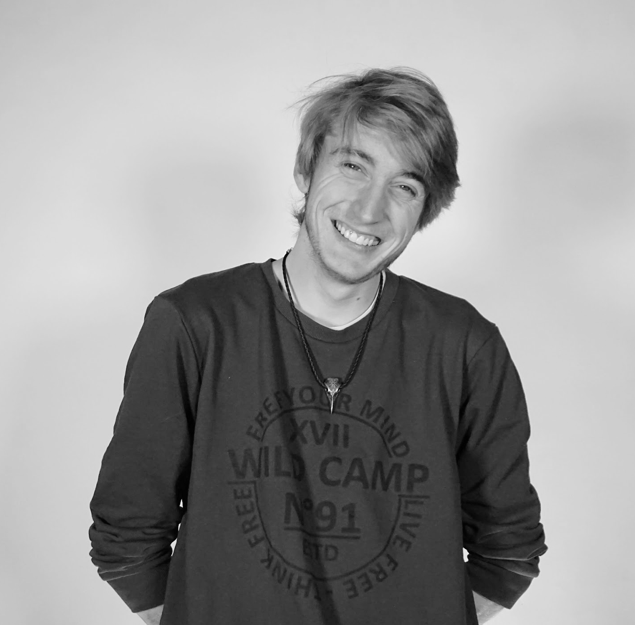
Group members
Delphine César linkedin.com/in/delphinecesar/
Dalanda Diallo linkedin.com/in/mdalanda-diallo/
Djalil Djebali linkedin.com/in/djalil-djebali/
Céline Martineau linkedin.com/in/cnmartineau/
Bastien Monin linkedin.com/in/bastien-monin/

Slide 3
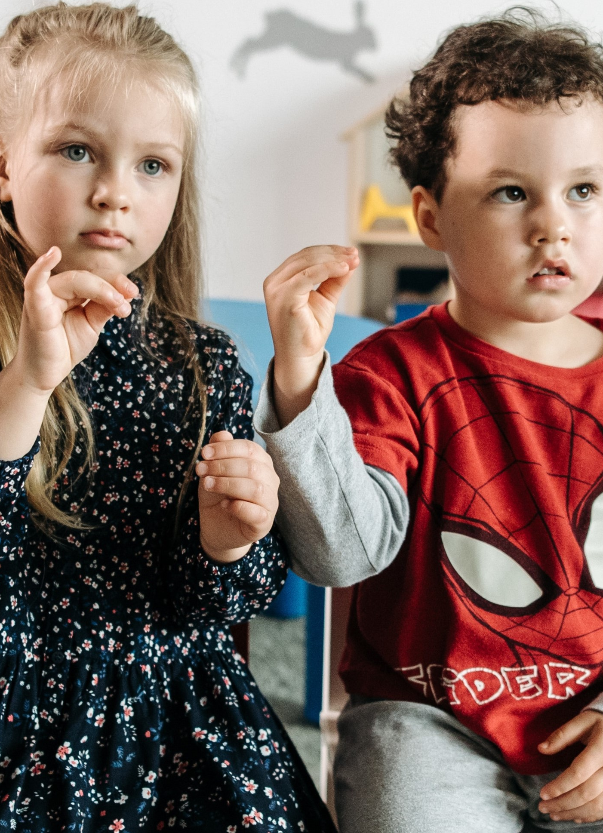
Pitch
Statement
AI could have a positive impact on people’s
life and our society.
Problem
Improve communication between deaf
and hearing people, especially children.
Users
Anyone who’s interacting with deaf children.
Context
No French translation application available.

Slide 4
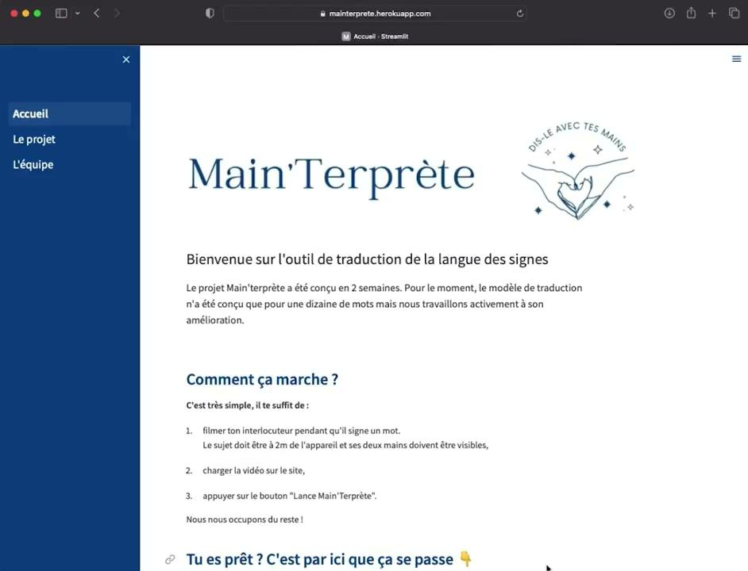
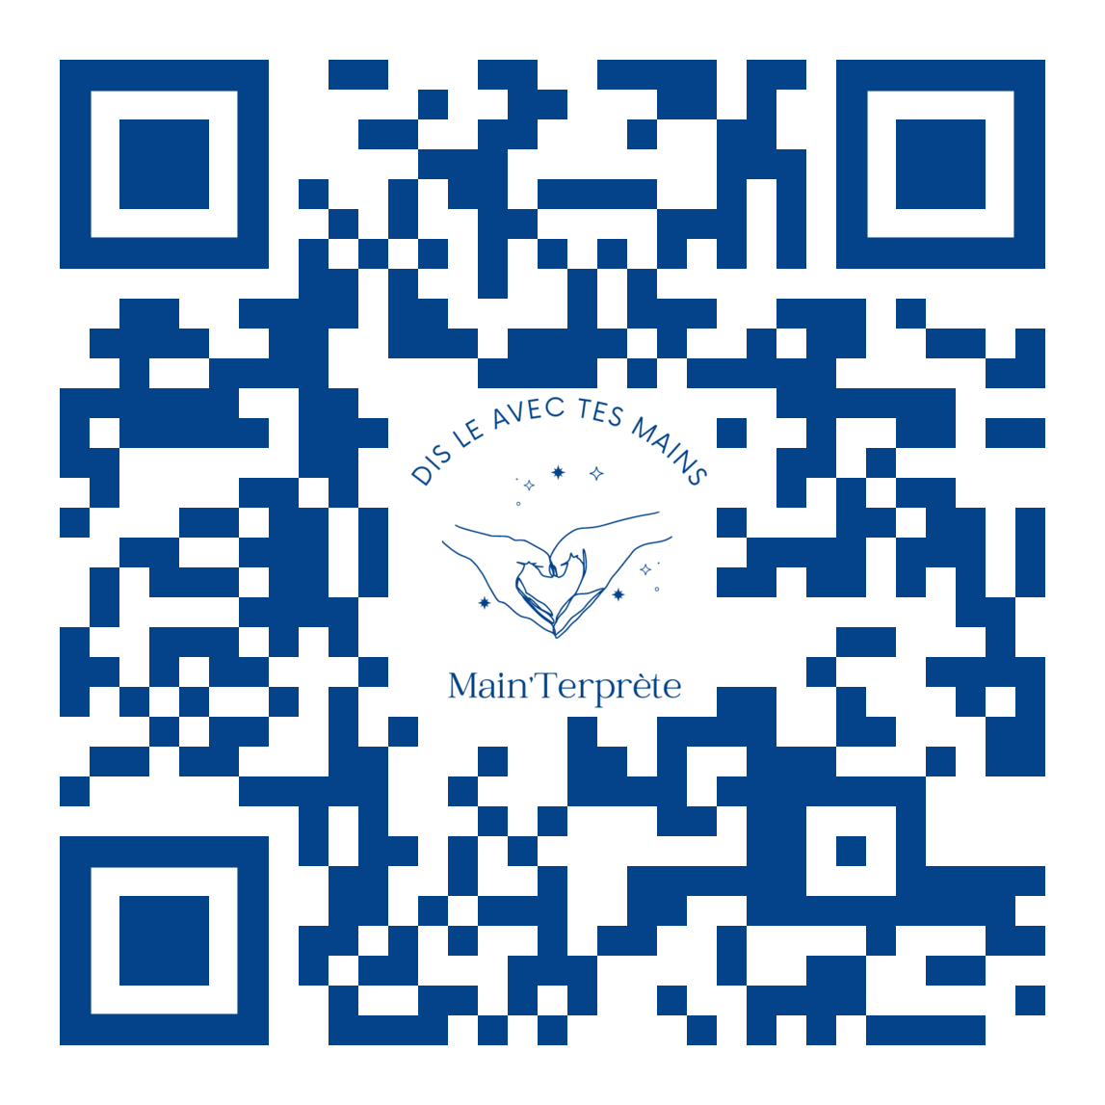
Results
3 interactive pages
Translate up to 10 words
Easy to use
https://mainterprete.herokuapp.com/

Slide 5
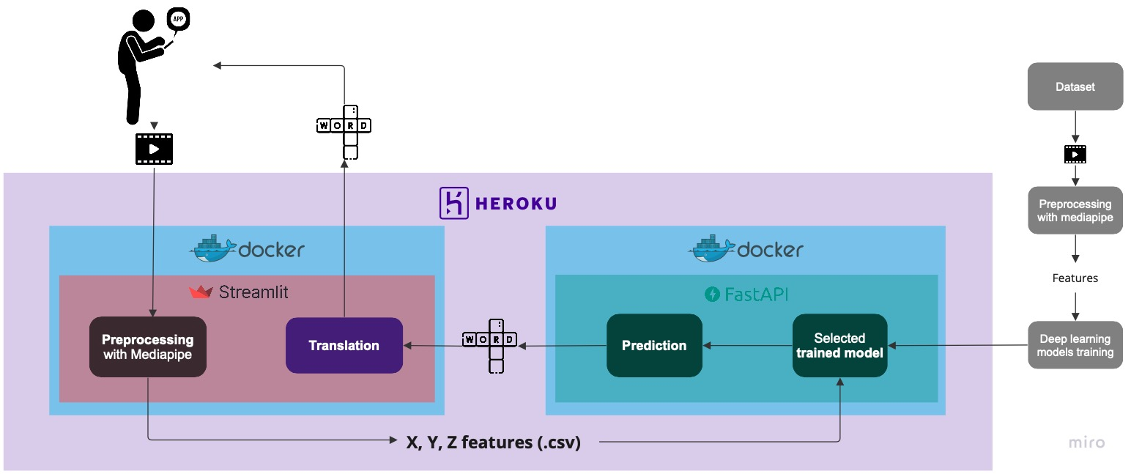
Solution description
Dataset https://lsfb.info.unamur.be LSFB | Model Subramanian B. et al., Sci Rep, 2022

Slide 6
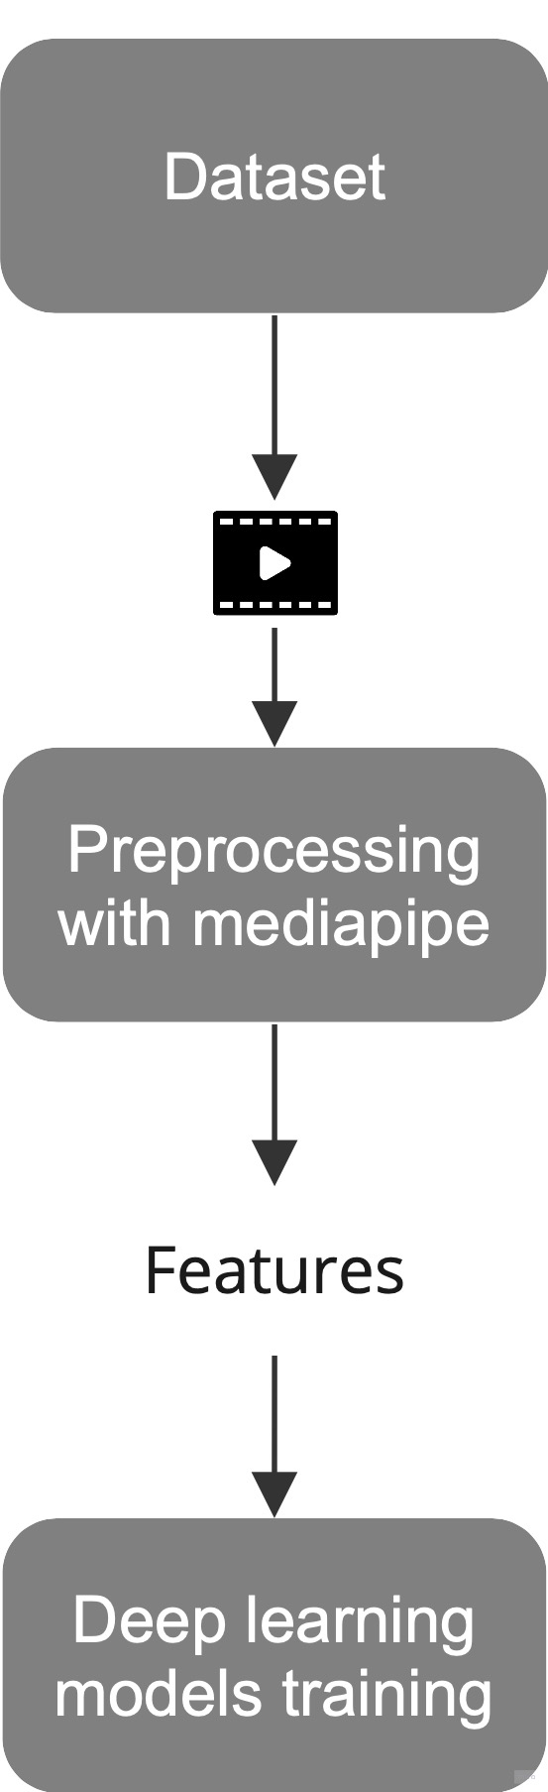
Solution description
Dataset
96,400 videos of people signing French words.
Preprocessing
From each video, extraction of X, Y, Z coordinates
of 553 landmarks.
Data selection
Top 10 words for a total of 14,000 .csv files.
Model
Sequential gated recurrent units.
Dataset https://lsfb.info.unamur.be LSFB | Model Subramanian B. et al., Sci Rep, 2022
Notes:
Methodology : videos of people signing from LSFB (scientific lab), methodology from Dr kim (Mediapipe Holistic + modified GRU)
Dataset : https://lsfb.info.unamur.be LSFB
Models: GRU
Technologies: Docker, Heroku, FastAPI, Streamlit (schéma)

Slide 7

What’s next?
How to improve the solution?
Add more words
Belgium vs France language specificities
Translate conversations
Improve servers capacity
How to go further ?
Talk to users to further understand
their needs and adapt our concept
Gather data from different backgrounds

Slide 8

Any questions ?

